Slide 1

ECEN 3593-001 Computer Organization
Lecture #18
1 March 2021

Slide 2


Agenda
Class Announcements
Phase 5
Chapter 4 - Forwarding

Slide 3
Class Announcements
Reading for the week
“Computer Organization and Design, The Hardware / Software Interface, RISC-V edition,” by David Patterson and John Hennessy
ISBN 978-0-12-812275-4
Chapter 4, “The Processor”
pages 236-314 (sections 4.1 thru 4.8)

Slide 4
Class Announcements
Phase 5 is in the 4%/day deduction phase
Phase 6 is posted – Target Date Sunday, March 7 at 10:00 PM
1%/day bonus, 4%/day deduction
Homework #3 will be posted by tonight
Due Tuesday, March 9 at 10:00 PM

Slide 5
HackCU Opportunity
HackCU is back with our biggest hackathon of the year, HackCU 007! The event will be held virtually from March 6-7 with lots of opportunities to meet and work with new people! Registration is now open and can be found here: tinyurl.com/hackcu007-signup. HackCU 007 is for all students regardless of your experience or your major— we have something for everyone! We have amazing sponsors who are looking to meet and recruit you, a variety of workshops for students of all levels, fun side events, 4 tracks to submit to, and lots of prizes! If you have any questions, check out our website hackcu.org/007 or contact us at contact@hackcu.org.
P.S. if you want to stay up to date with the details of the event or other workshops we’re hosting this semester, follow us everywhere @hackcu or sign up for our newsletter on hackcu.org.

Slide 6
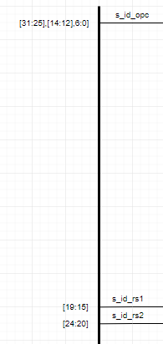
Codasip Optimization
If a signal isn’t used, Codasip will optimize out it’s entire path
All signals start at the value 0 and remain there unless changed
Can produce unexpected behavior
s_id_instr has a real value in bits [19:15]
s_id_rs1 is not connected
s_id_rs1 will be 0
Real hardware doesn’t work like this!
Can also cause instructions to be “skipped”

Slide 7
Phase 5 Questions?

Slide 8
Phase 5
Read the instructions carefully
Use your schematics!
Be careful with signal widths – every pipeline register must have the same input and output width

Slide 9
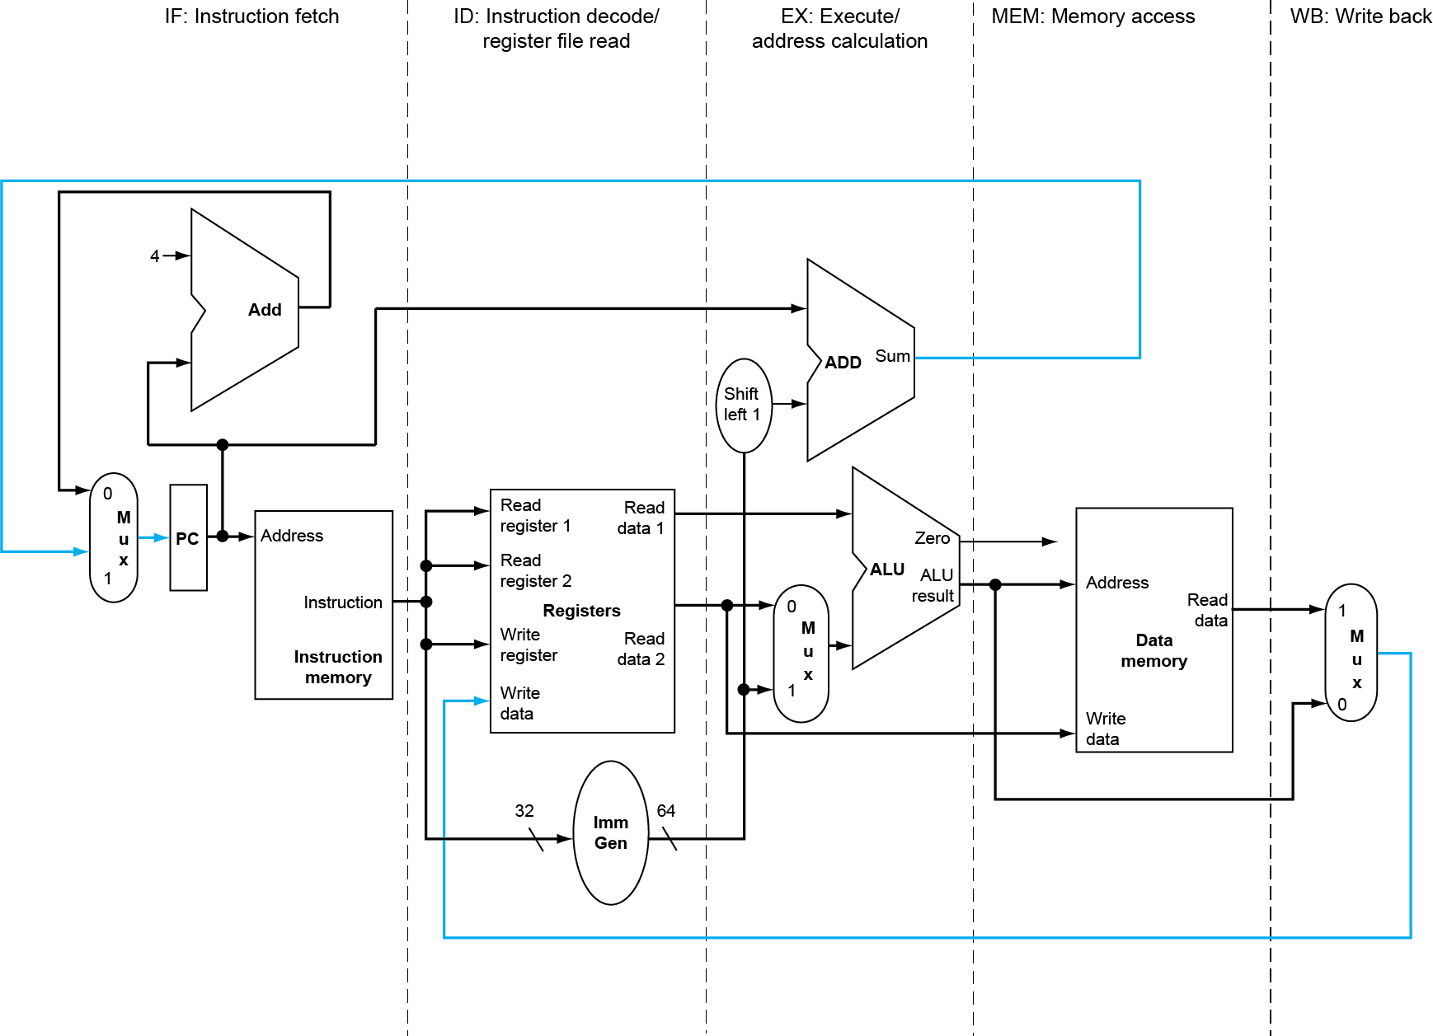
A 5-stage RISC-V Pipelined data path
MEM
Right-to-left flow leads to issues
WB
Data flowing from the right to the left does not affect the current instruction, it only influences later instructions in the pipeline

Slide 10
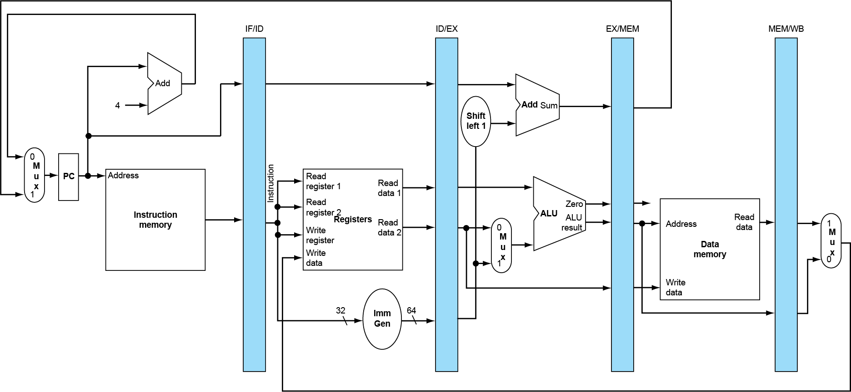
Storing the internal state of the Pipeline
Need Pipeline registers between stages to pass the instruction along
The pipeline registers retain the value of an individual instruction as it goes from one stage to the next.
The values could include the instruction itself or the decoded control bits that will be used in future stages of the pipe
Notice that each pipeline stage requires a unique set of resources – preventing a structural hazard

Slide 11
Pipeline Operation
Diagraming cycle-by-cycle flow of instructions through the pipelined data path
“Single-clock-cycle” pipeline diagram
Shows pipeline usage in a single cycle
Highlight resources used
Compared to a “multi-clock-cycle” diagram
Graph of operation over time
We’ll look at “single-clock-cycle” diagrams for load & store

Slide 12
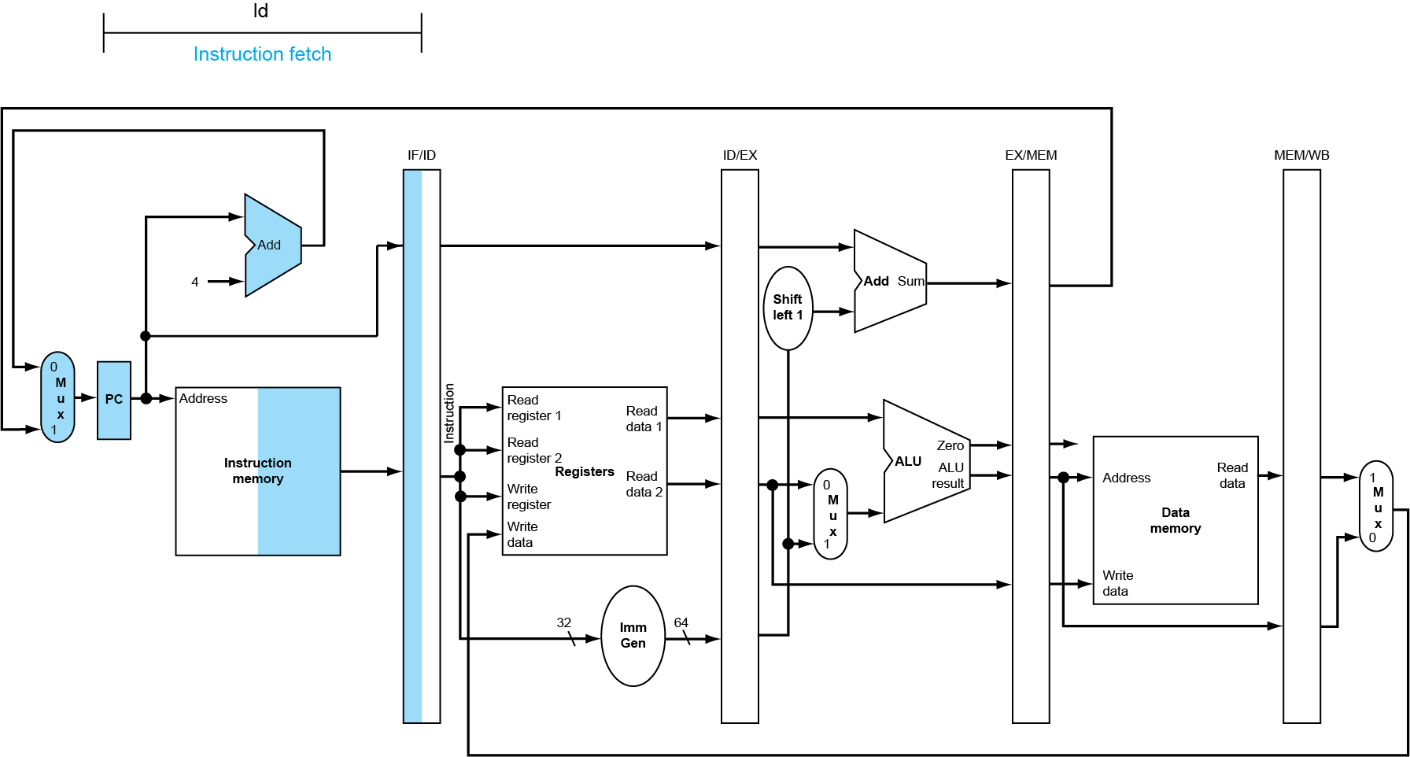
Instruction Fetch (IF) for a load / store
The incremented PC counter value, PC, is also placed in the IF/ID pipeline buffer to be used in a calculation of a branch
At this stage, the CPU does not know what type of instruction has been fetched

Slide 13
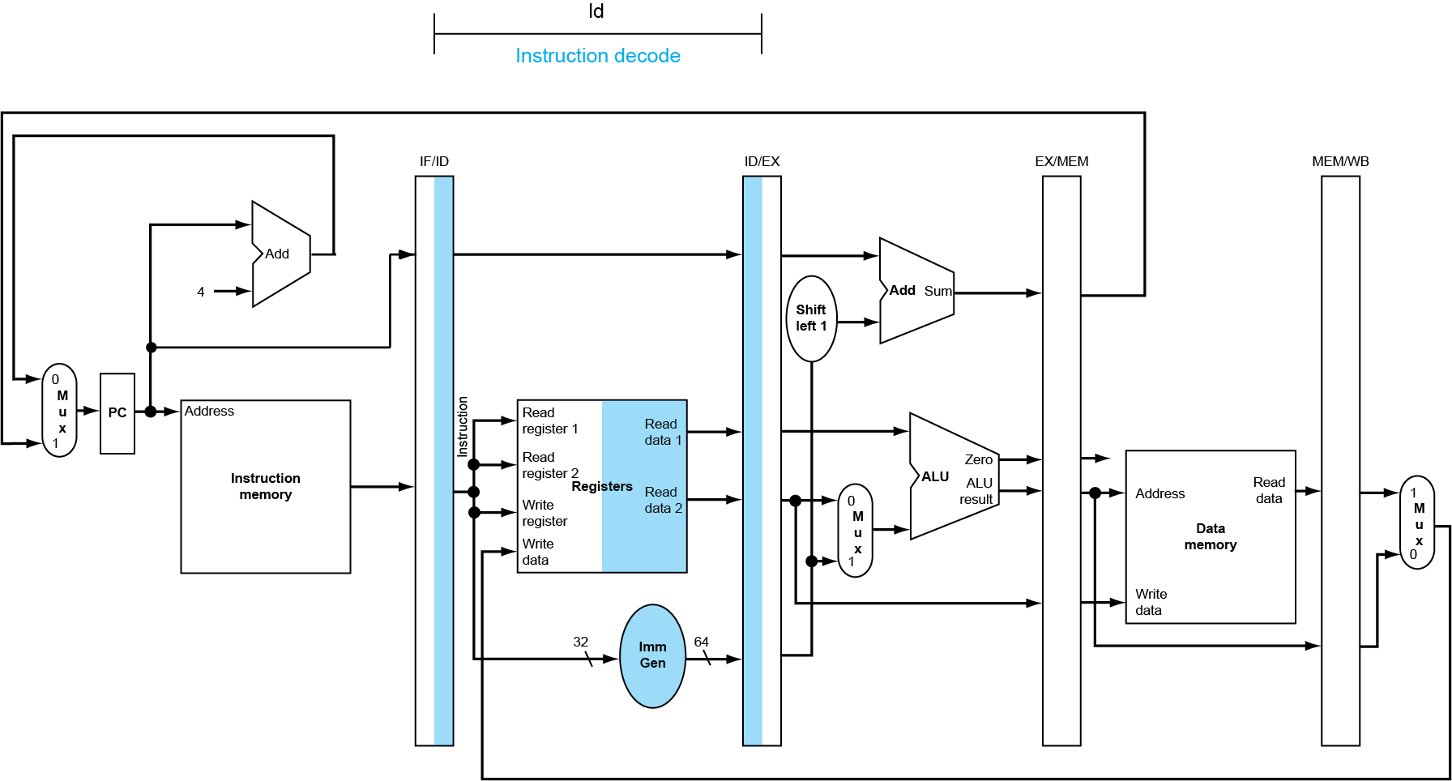
Instruction Decode (ID) for a Load / Store
The value of the register operands as well as the signed extended immediate value are placed into the ID/EX buffer to be passed int the EX stage if necessary
The instruction is also decoded into the control lines required for the EX, MEM, and WB stages
Note: The PC counter value is also passed along to the ID/EX register
The register file is required in 2 stages, the ID and WB stage. Is this a Structural Hazard?
No, but there is an issue.

Slide 14
Register File
On write, cannot read the newly written value
Register is in the path – load it on one clock
Load this register on the NEXT clock edge
WB Stage
Reg
rs2
rs1
din
clock
5-32 Decoder
Reg31
64-bit
32-1
Mux
64-bit
32-1
Mux
Reg30
Codasip does not have the inversion
Doesn’t matter in Phase 5, but we will make an update in Phase 6
…
rd
Reg4
Reg3
Reg2
Reg1
zero
Reg
load WB
dout2
din
load REG
dout
load ID
dout1
clock
Negative edge clocking
ID Stage

Slide 15
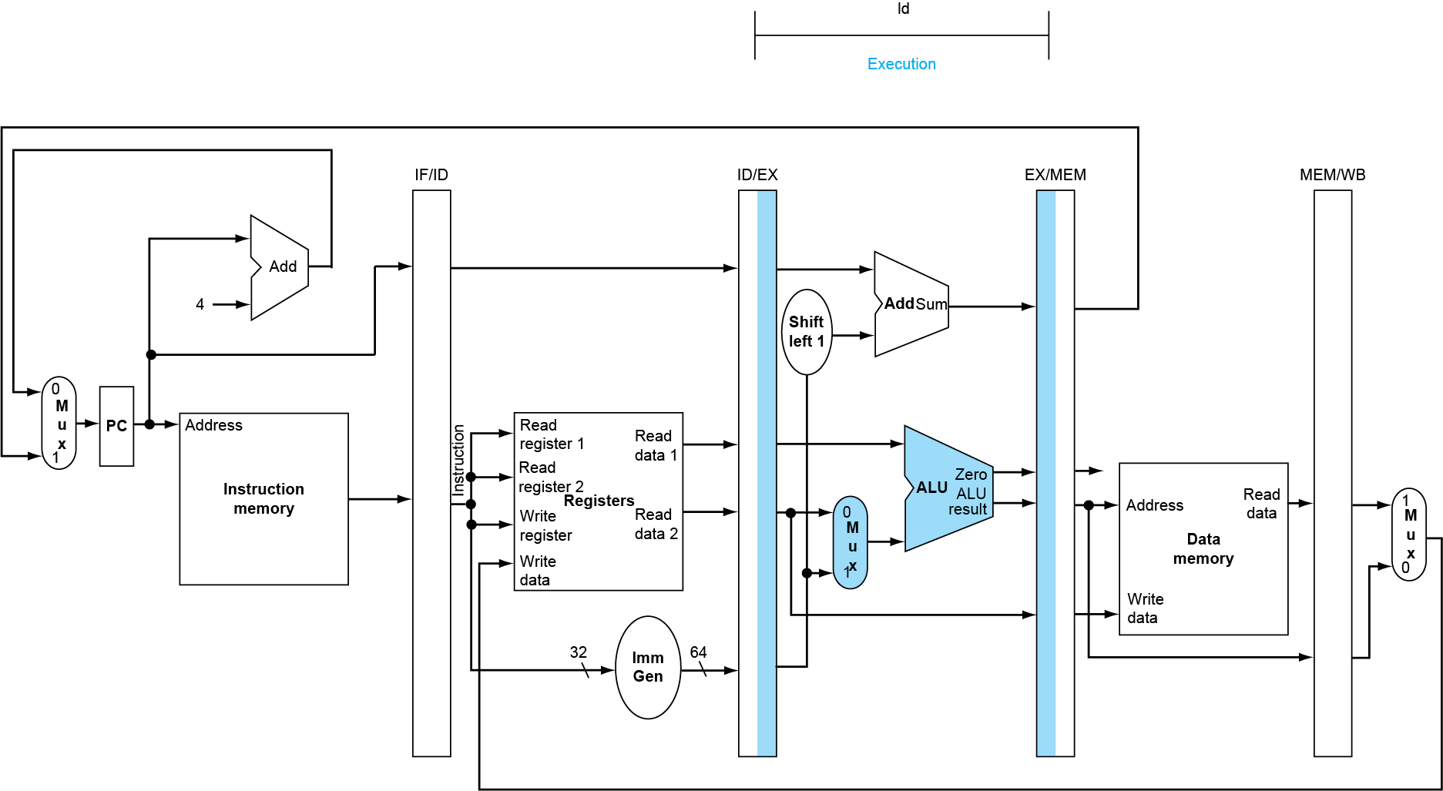
Execute (EX) for Load
The ALU result is written into the EX/MEM register to be used as the address to the data memory
The control lines developed in the ID staged are passed further along into the EX/MEM register

Slide 16
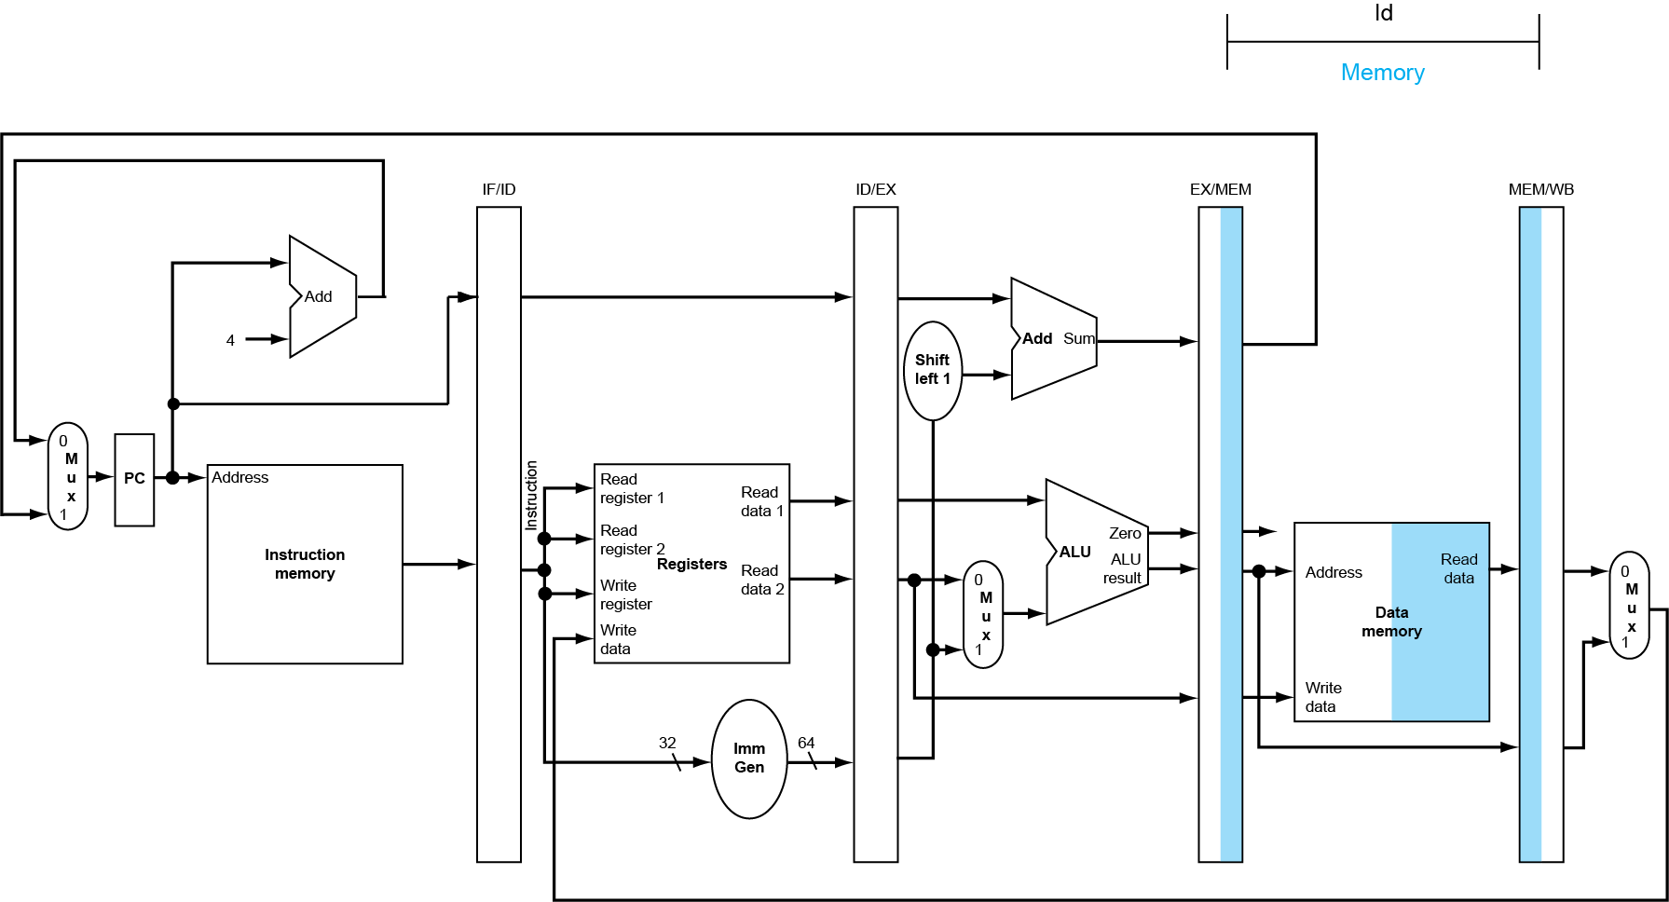
Memory Access (MEM) for Load
The value read from the memory and the output of the ALU are passed to the MEM/WB pipeline register to make these results available during the WB stage
The ALU output can’t be written to the Register File yet – why? (Poll)
The control lines developed in the ID staged are passed further along into the MEM/WB register

Slide 17
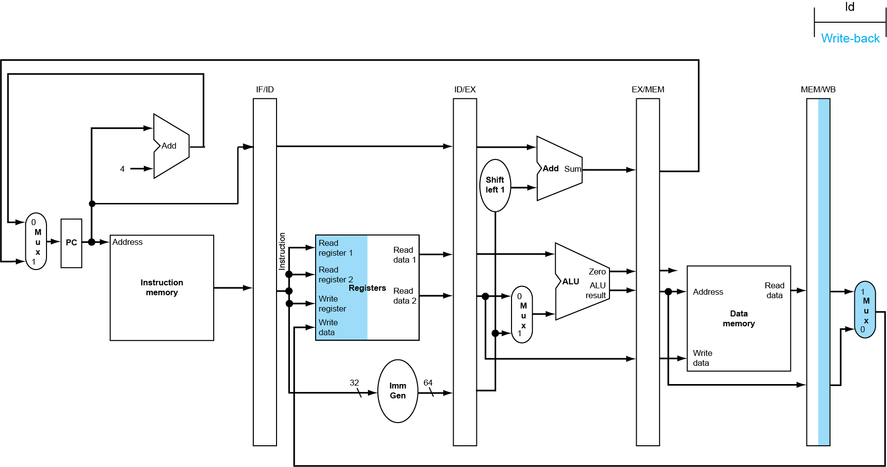
Write Back (WB) for Load
The mux from the WB stage determines what data is written, the ALU output or the data memory, if a write will be occurring to the register file
But – the destination index to the Register File is wrong!
Wrong register number

Slide 18
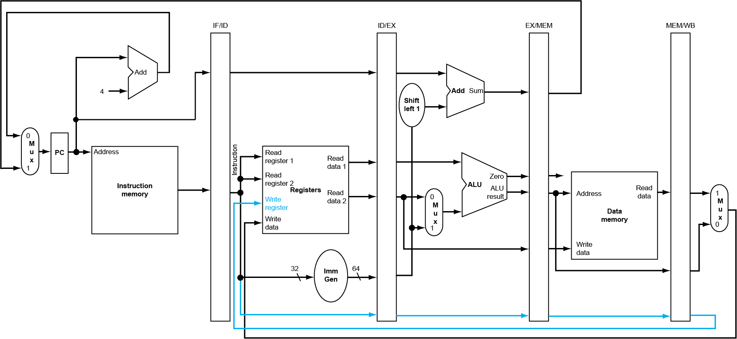
Corrected data path for Register Writes
To provide the correct register to write, the write register index must come from the MEM/WB pipeline register
This is why we pass the rd field down the pipeline and use it in the WB stage

Slide 19
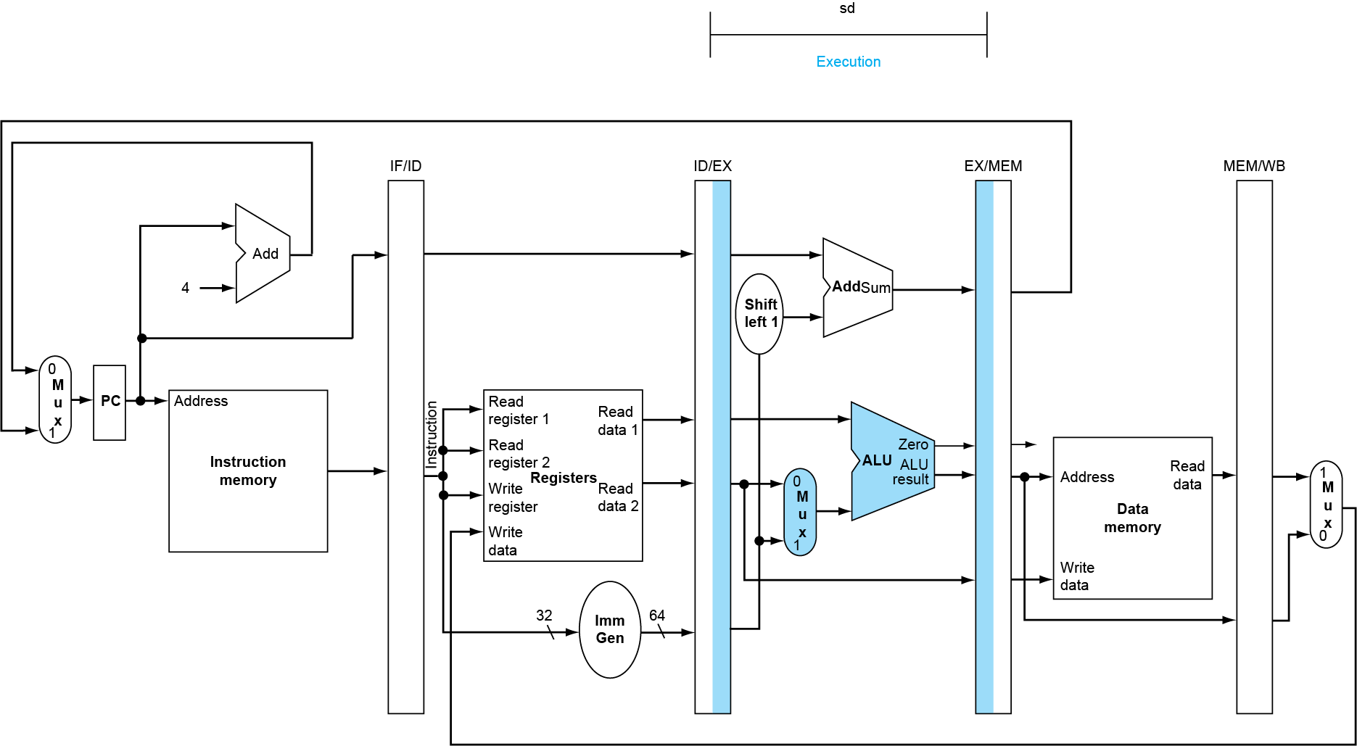
Execution (EX) for Store
The value to be stored to the data memory is passed from the ID/EX register to the EX/MEM register
The ALU uses the signed extended result from the ID/EX register to calculate the address for the store
The ALU result is stored into the EX/MEM register to be used as the memory address

Slide 20
Memory Access (MEM) for Store
With the store operation completed in the MEM pipeline stage, the control lines passed into the MEM/WB register are effectively a NOP operation for the WB stage

Slide 21
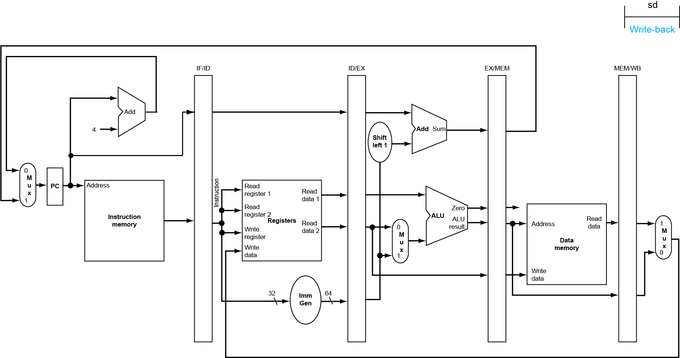
Write Back (WB) for Store
Note that since the Store does not write data to the register file, no activity is shown for a Store in the Write-back pipeline stage

Slide 22
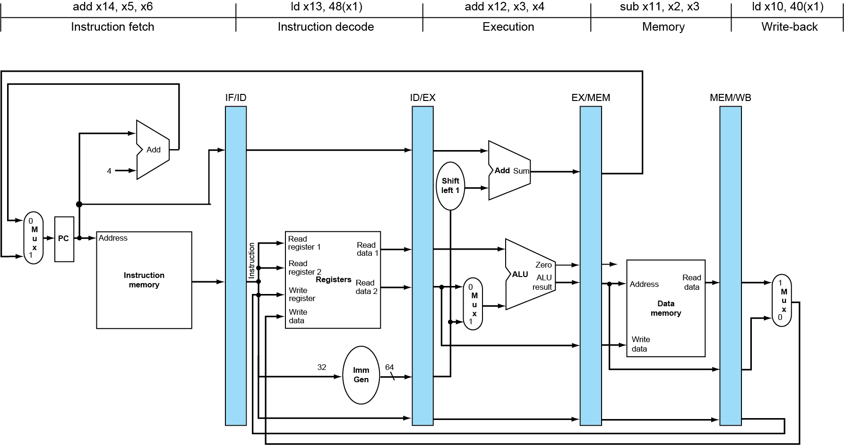
Single-Cycle Pipeline Diagram
Displays the state of each pipeline stage at any given clock cycle

Slide 23
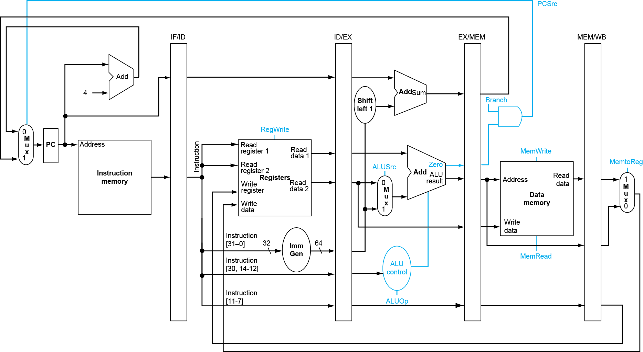
Pipeline Control (Simplified)
In the decode stage, the incoming instruction is always decoded, so no special controls are required in this stage
In the execute stage, selecting the register or immediate value as well as the ALU are passed from the decode stage
In the memory stage, the branch, mem read or write are passed from the decode stage while the branch determination is passed from the ALU stage
In the write back stage, the selection to write back the result of the ALU or data memory read is passed along from the decode stage.
In addition the register address is passed along from the decode stage
In the fetch stage, the PC and the Instruction Memory are always accessed every cycle => no special controls are required

Slide 24
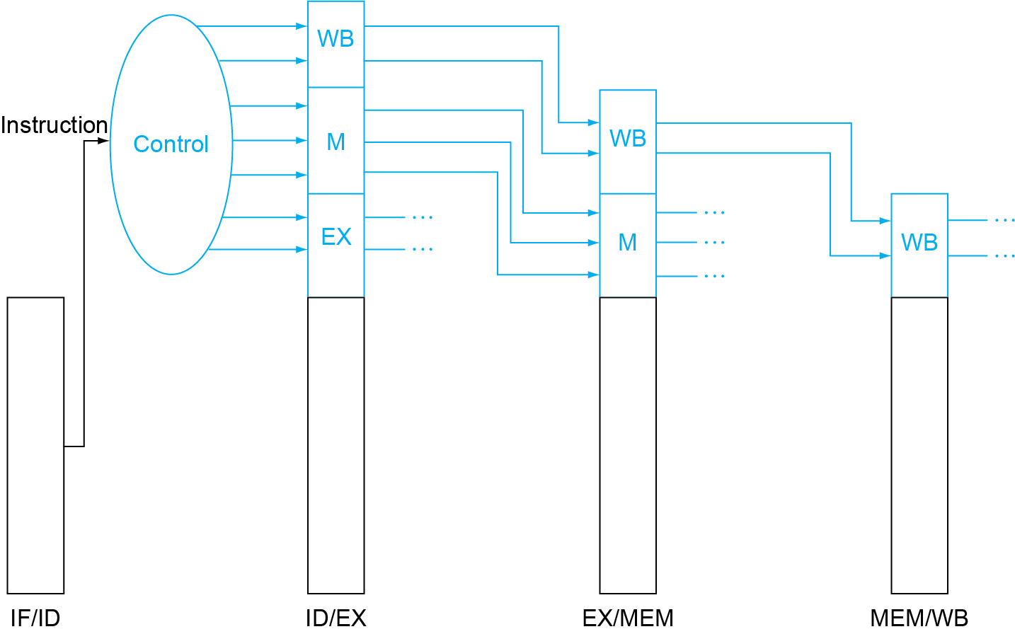
Pipeline Control
Control signals are derived from instruction
As in single-cycle implementation
This is the DECODER

Slide 25
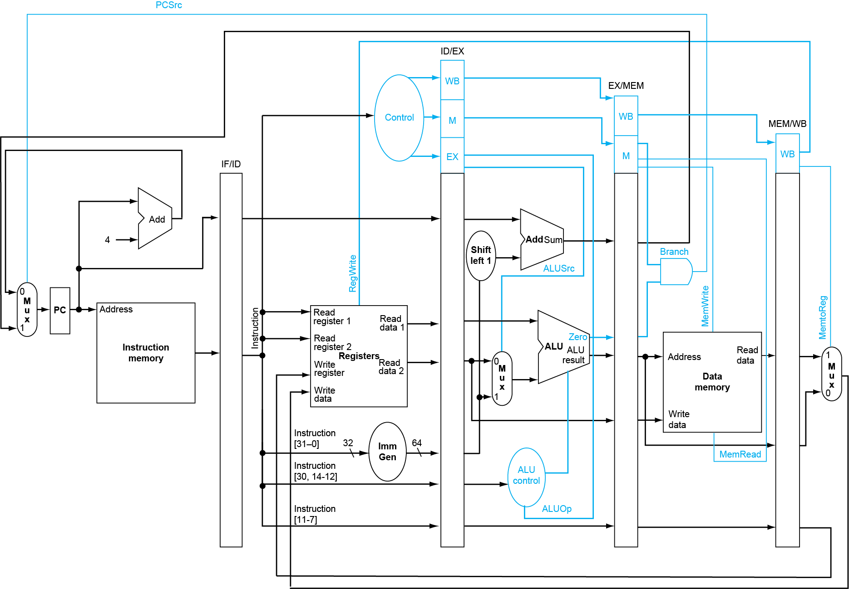
Pipeline Control
Since the data path (the pipeline) does not change the meaning of the control lines, they can be generated in the ID stage DECODER and they can remain the same through each stage of the pipeline
The key is to insure that the control lines remain synchronized with the data path which is done by using the same pipeline registers

Slide 26
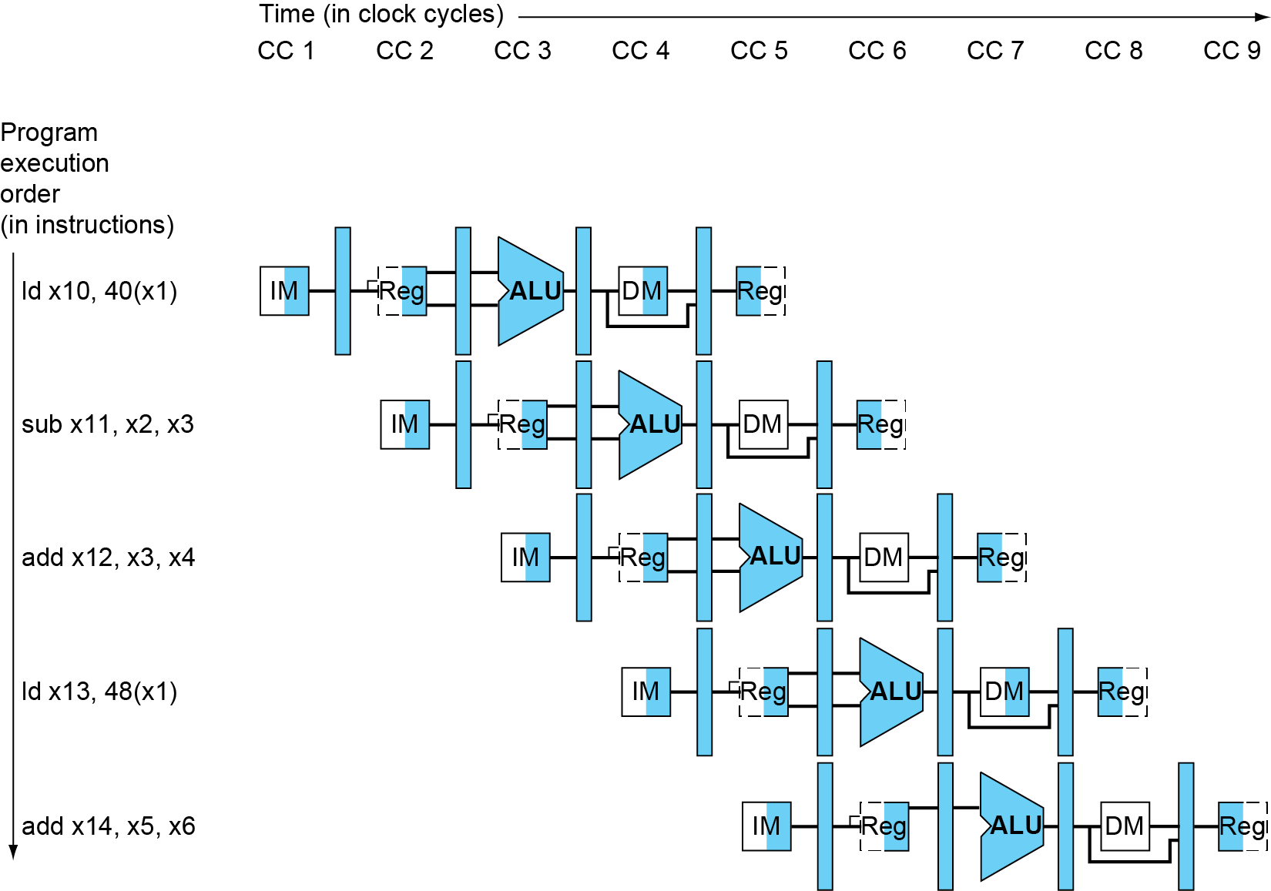
Multi-Cycle Pipeline Diagram
Diagram that shows resource utilization

Slide 27
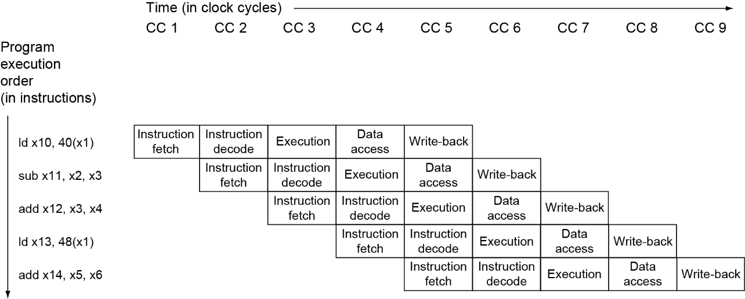
Multi-Cycle Pipeline Diagram
Traditional form of multi-cycle pipeline diagram

Slide 28
Data Hazards in the ALU
Consider this sequence:
sub x2, x1,x3 and x12,x2,x5 or x13,x6,x2 add x14,x2,x2 sd x15,100(x2)
We can resolve hazards with forwarding
By forwarding the data as soon as it is available to any unit and not wait for it to return to the register file
How do we detect when to forward?
Stalls or nops or forwarding must be inserted here
Stall or nop or forwarding must be inserted here

Slide 29
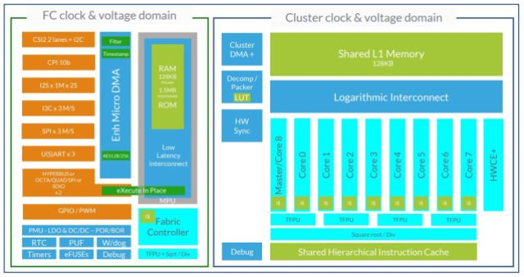
Interesting RISC-V Company
Greenwaves (UK)
AI Accelerator
Multiple RISC-V Cores
Execution Array (9 cores)
Shared Data Memory
Shared Instruction Memory (Cache)
Fabric Controller (1 core)
Plus low intensity compute

